Slide 1
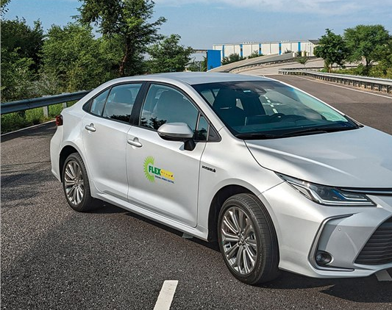
Case Study On: Why ETHANOL POWERED VEHICLES WILL FAIL
Created by:
Kuldeep Singh Shekhawat

Slide 2
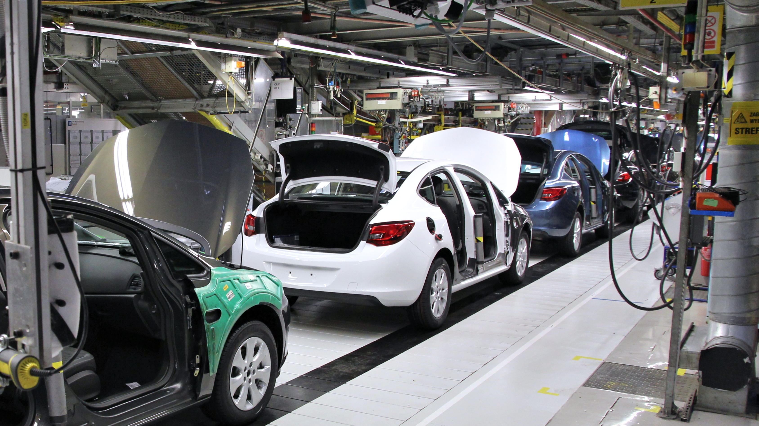
Market Size of Automobile Industry:
The $222 bn automobile industry is expected to reach $300 bn by 2026
In the Automobile market in India, Two-wheelers and passenger cars accounted for 76% and 17.4% market share, respectively. Passenger car sales are dominated by small and midsized cars

Slide 3
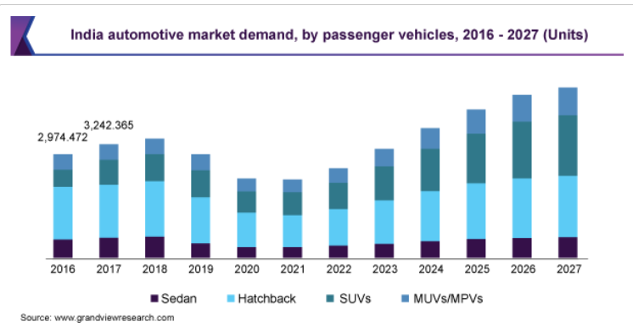
Demand graph of vehicle

Slide 4

Ethanol Fueling Infrastructure Development
Е10 (10% ethanol, 90% gasoline) is available at nearly every fueling station. There are more than 3,700 public stations in 42 states offering E85 (or flex fuel)-a gasoline-ethanol blend containing 51% to 83% ethanol, depending on geography and season. As of 2021, E15 was sold at more than 2,400 stations in 30 states. Some stations offer multiple ethanol blends at one location, often through blender pumps

Slide 5

Raw Material Availability
Most of the ethanol is produced from renewable raw materials, which are essentially sources of carbohydrates as sugars (sugarcane, beet, sweet sorghum, Jerusalem artichoke, fruits), starch (corn, wheat, cassava, sweet potato), and lignocellulosic materials.

Slide 6

Suppliers of Ethanol
Bajaj Hindusthan Limited had a crushing capacity of up to 400 Tonnes of cane each day. The same mill can now crush 13000 Mt of sugar cane per day.
Balrampur Chini Mills Limited . The company h as a 520 KLPD ethanol distillation capacity and a 76500 TCD cane crushing capacity

Slide 7
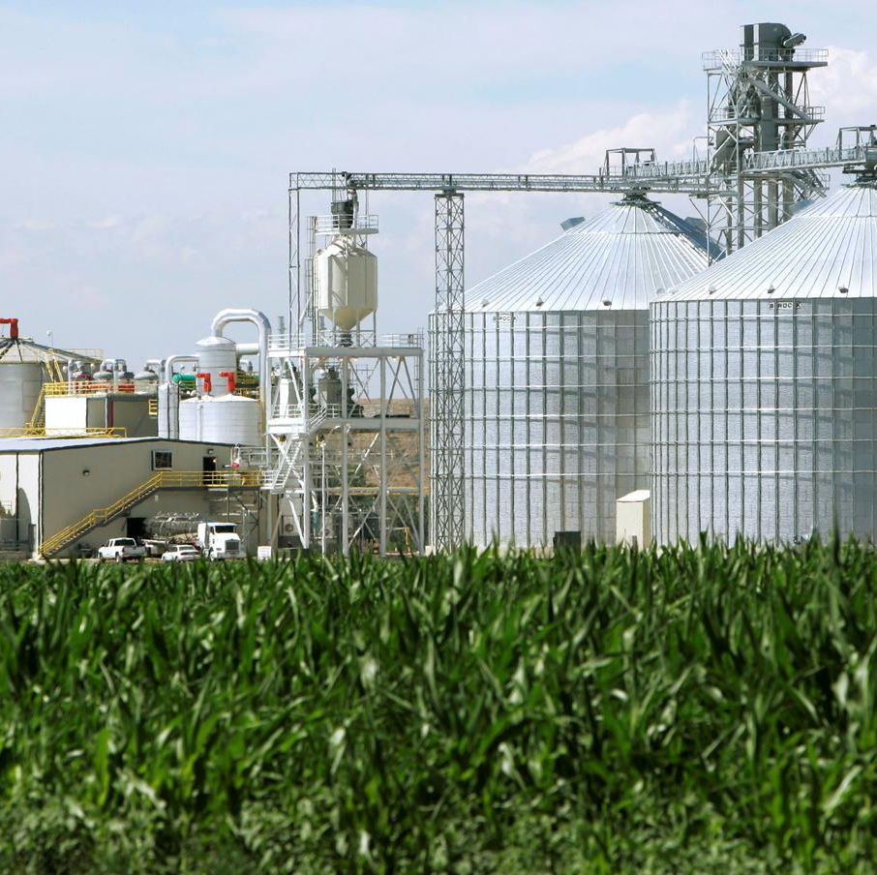
PROS OF ETHANOL FUEL
• Ethanol Fuel is Cost-effective Compared to Other Biofuels • Helps Reduce Global warming • easily accessible • Minimizes Dependence on Fossil Fuels • Contributes to Creation of Employment to the Country • Variety of Sources of Raw Material

Slide 8
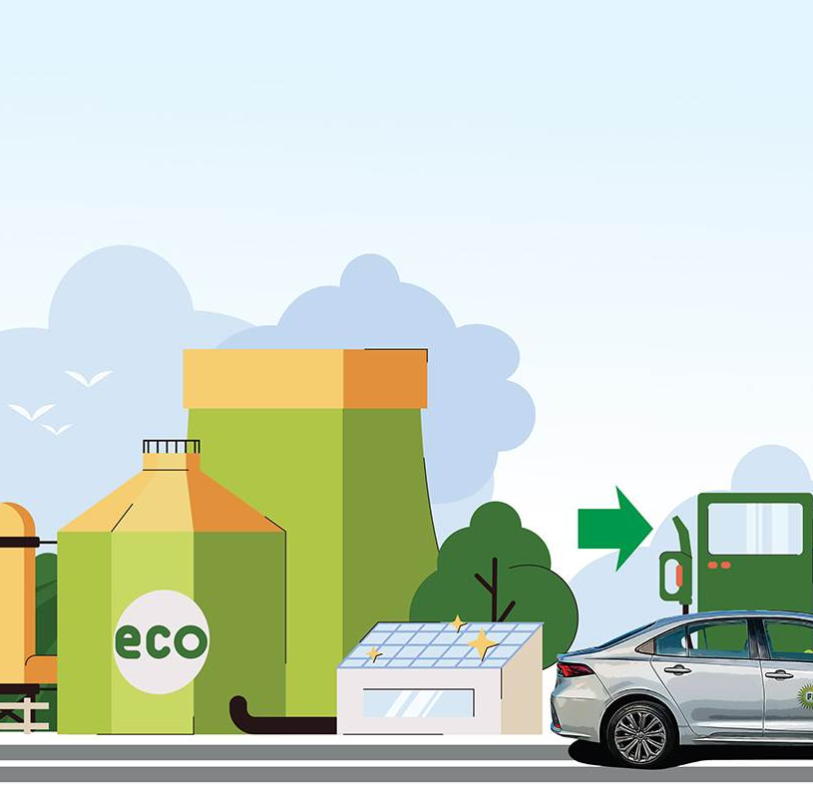
CONS OF ETHANOL FUEL
• Requires a Large Piece of Land
• It isn’t as effective a fuel as traditional gasoline
• Spike in Food Prices
• Affinity of Water
• Difficult to Vaporize

Slide 9
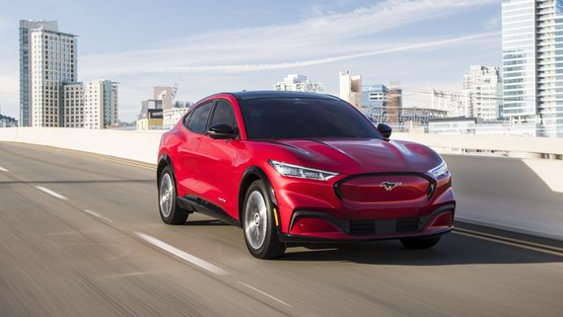
Expected Growth in Near Future for Ev’s:
By 2030, the number of EVs on road is expected to increase – 45-50 million EVs – while annual sales are expected to reach 10 million per annum, clocking a Compound Annual Growth Rate(CAGR) of 49% between 2022 and 2030.
India is riding fast toward its goal of carbon neutrality by the year 2070. Naturally, the transportation sector, one of the biggest polluters, has to be brought under green cover the nation wants to reduce the emissions intensity of its GDP by 45 per cent by 2030 and its a medium-term goal.

Slide 10
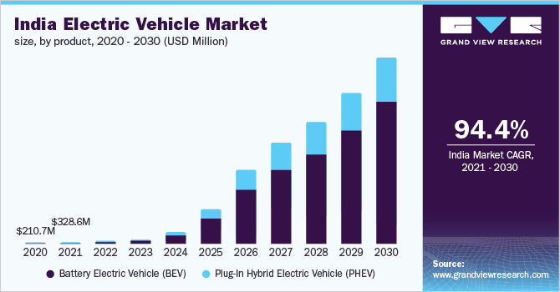
Demand OF Electric vehicle

Slide 11
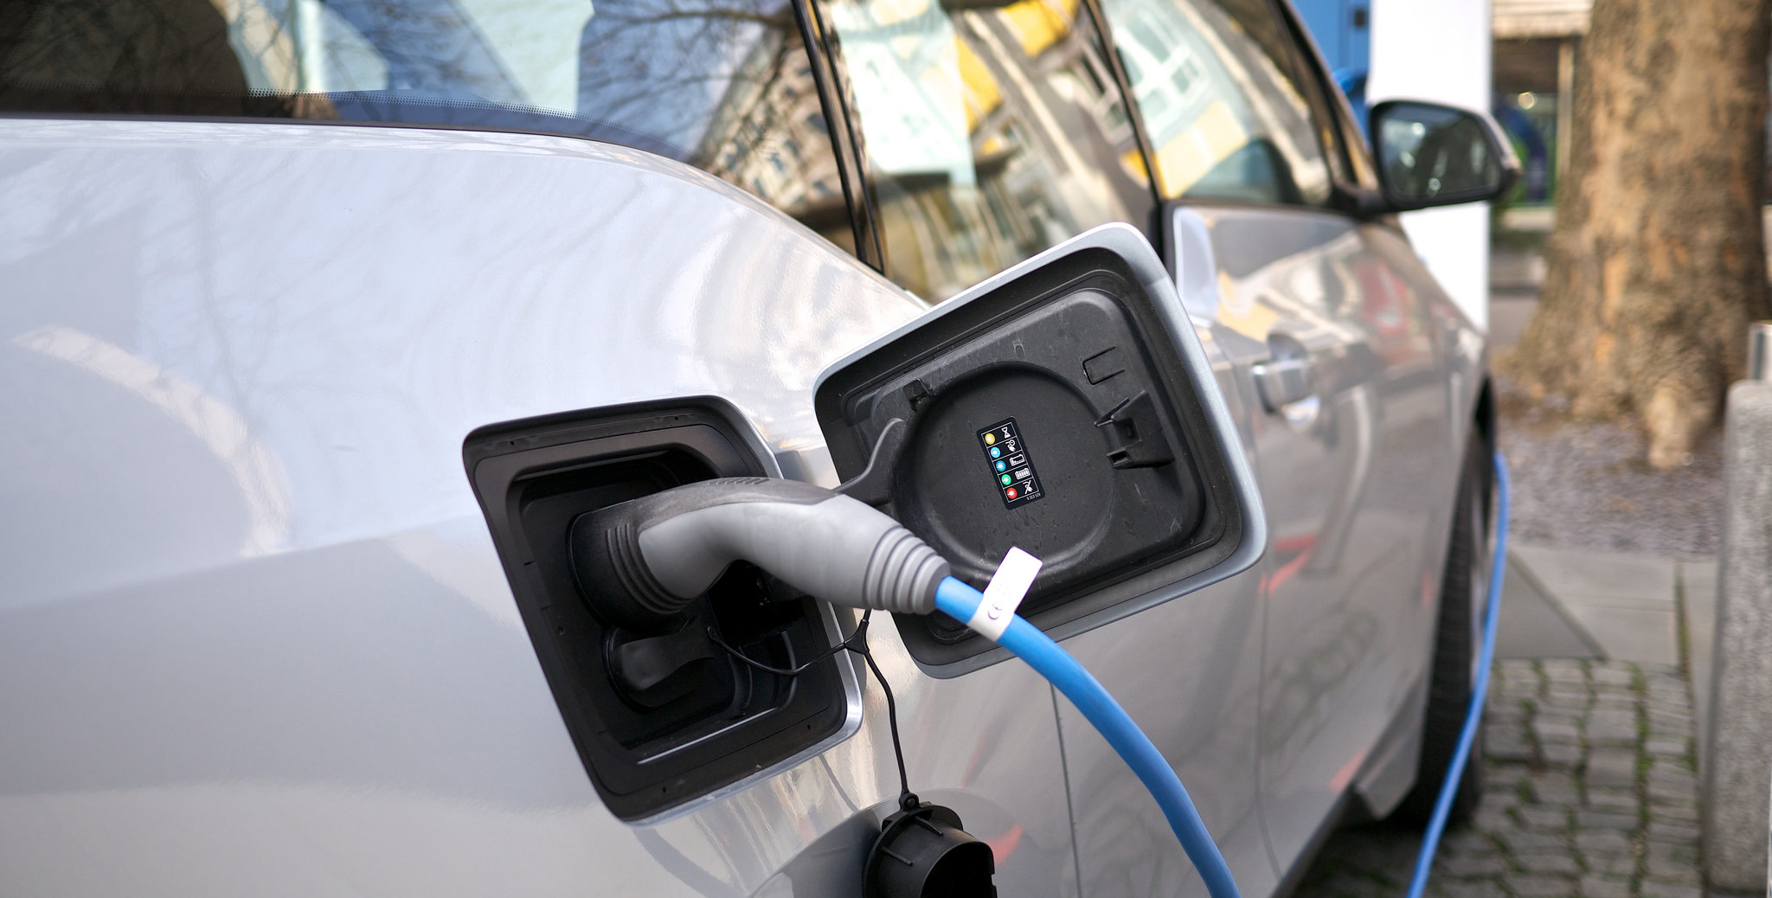
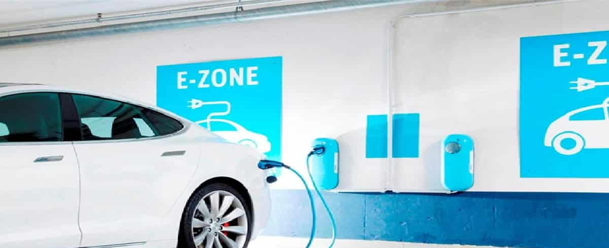
Suppliers for Raw materials and expertise
Battery manufacturers: Companies that produce the batteries used in electric vehicles, such as Tesla, Panasonic, and LG Chem
Automotive manufacturers: Traditional car manufacturers that are now producing electric vehicles, such as General Motors, Ford, and Volkswagen
Electric motor and power electronics manufacturers: Companies that produce the electric motors and power electronics used in electric vehicles, such as Tesla, Bosch, and Continential.
Charging infrastructure companies: Companies that provide charging stations, software and other related services for EV charging infrastructure, such as Chargepoint, Tata, and Tesla.
This Photo by Unknown Author is licensed under CC BY-NC
This Photo by Unknown Author is licensed under CC BY

Slide 12
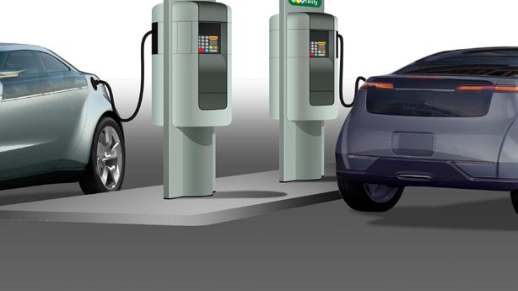
At End Electric Will Overtake Ethanol
Thankyou
This Photo by Unknown Author is licensed under CC BY

